Slide 1
Marketing management
Made by:-
Rajan Bhatt
160410116018
IT 1
Guided by –prof. Disha Patel

Slide 2
MARKET
The term market has no any reference to place but it is always to a commodity in which buyer and sellers transact in direct competition with one another.

Slide 3
Introduction To Marketing Management
four areas of management
Help to improve standard of living
activity brings economic prosperity of nation & citizen
Support & generate more jobs

Slide 4
Characteristic Of Marketing Management
Implies markets needs & preferences
Product & services must be related to the target market needs
Company should constantly monitor their services are satisfy the customers or not
Exchange
Plan , organizes , direct & controls the activities
Design , pricing , distribution

Slide 5
Marketing Mix
FOUR P’s OF MARKET
Product
Price
Place
Promotion

Slide 6
Product
Philip kotler - ‘Bundle of satisfaction’
study of consumer’s willingness , trade
3 stages
Segment
Targeting
positioning

Slide 7
Price
For marketer price decided in relation to the cost of product
For customer price linked to his perceived satisfaction level
Depends on market structure
Sensitive factor

Slide 8
Place
‘channel of distribution’
Channel selection
production
process industry
job industry
degree & automation
Markets
area of the market-rural , national
structure of the market

Slide 9
Products
consumer products
perishable goods
Customers
number of customers
frequency of buying

Slide 10
Promotion
Target audience
Construction of massage
Media selection
Follow up

Slide 11
CONCEPT OF MARKETING
Production concept
Product concept
Selling concept
Marketing concept
Societal marketing concept
Holistic concept

Slide 12
Production concept
consumers are in favor of the product
prevents in under developed countries
also where less quantity than the demand
Product concept
consumers are in favor of best quality product
‘quality product & reasonable price’
Selling concept
consumers buy only interested product

Slide 13
Marketing concept
‘find wants and fill them rather than create products and sell them’
Societal marketing concept
argued that in the evolutionary process of various concept
determines the needs and wants and desired satisfaction
Holistic concept
take global consideration
cultural level becomes basis of MM

Slide 14
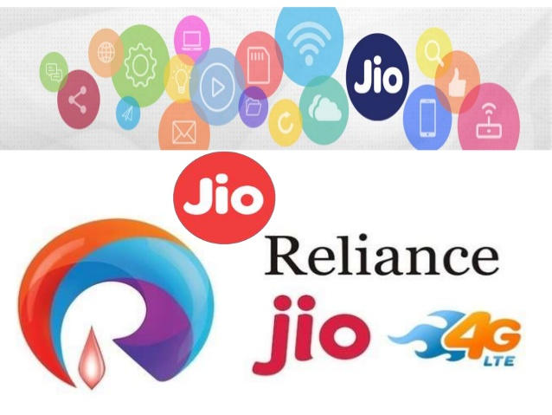
CASE STUDY

Slide 15
ABOUT
OWNER -Mukesh ambani
PERENT -Reliance industries
SUBSIDIERIES –LYF
KEY PEOPLE – Sanjay Mashruwala (managing director)
- Jyotindra Thacker (head of IT)
- Akash Ambani (chief of stratagy)

Slide 16
PRODUCT
JIO SIM
JIO NET
LYF PHONE

Slide 17
PROMOTION
various strategies of promotions
Adapt to the current goal of the nation
Placing the promotion in the books
Social media

Slide 18
DIGITAL REVOLUTION
Life is going Digital
India can not be left behind
Jio will take India in top 10 globally
We need digital tools & skills

Slide 19
STRATAGIES
OLIGOPOLY MARKET
QUALITY SUBSCRIBERS
VOICE LTE

Slide 20



Slide 21


